Slide 1
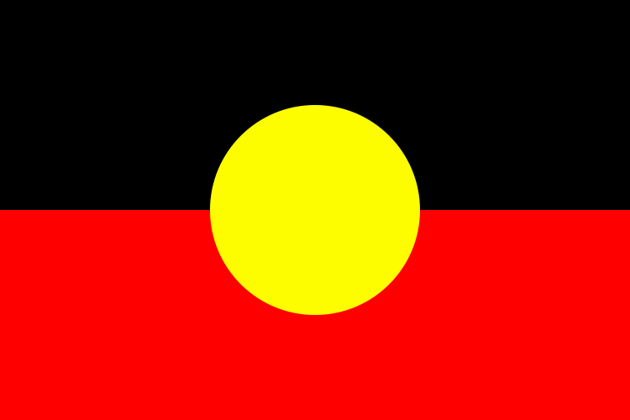
The Aboriginals

Slide 2
The Dharug

Slide 3
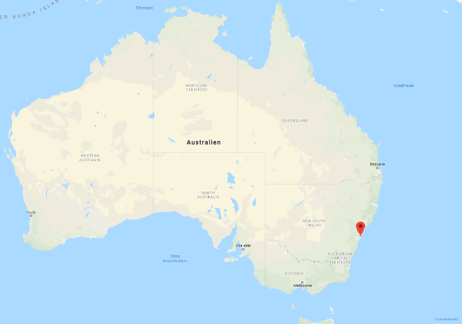
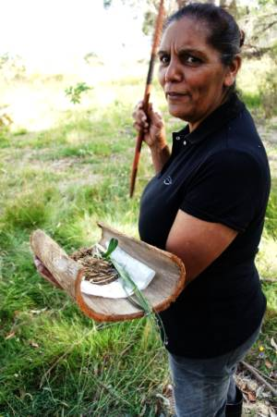
The dharug

Slide 4
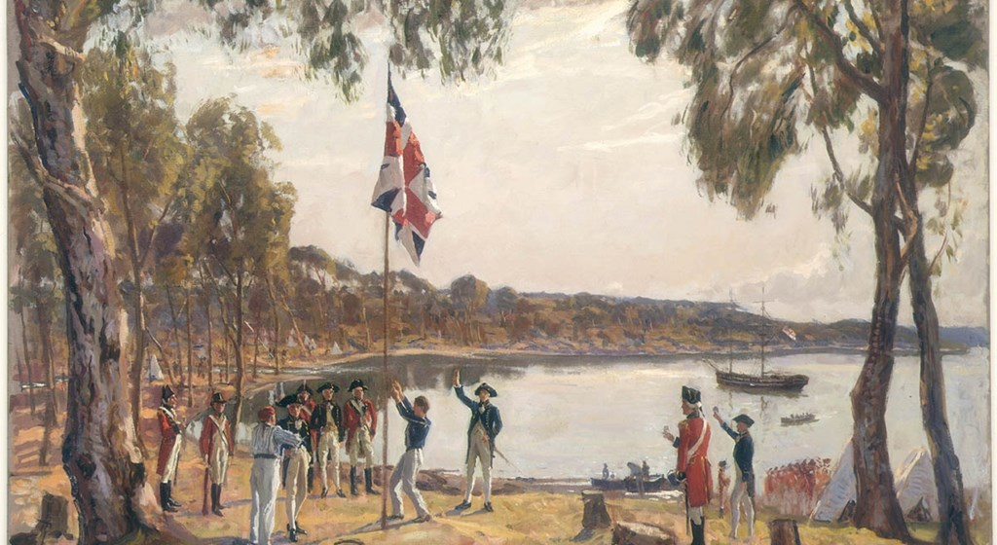
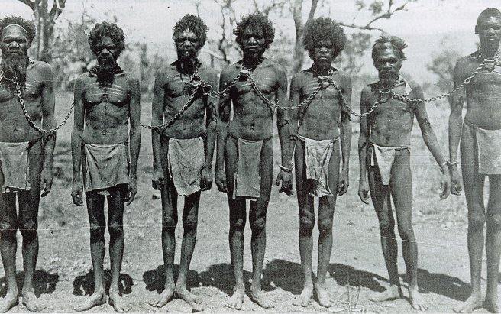
The Aboriginal people
What was told
what actually happened

Slide 5
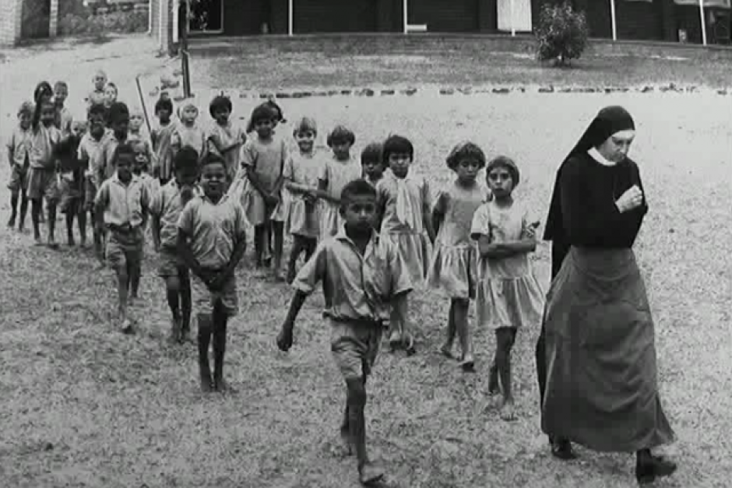
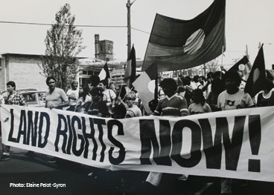
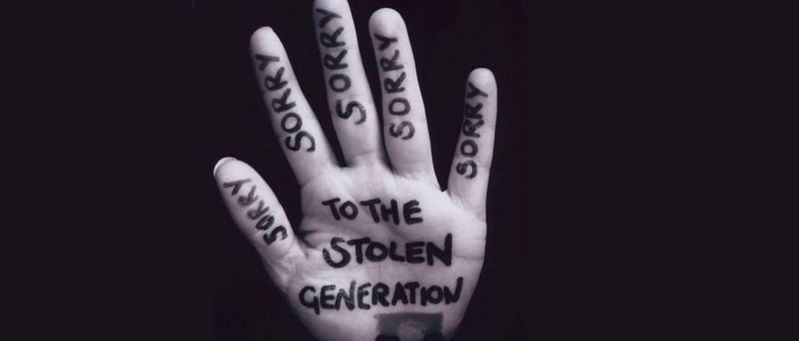

The stolen generation

Slide 6
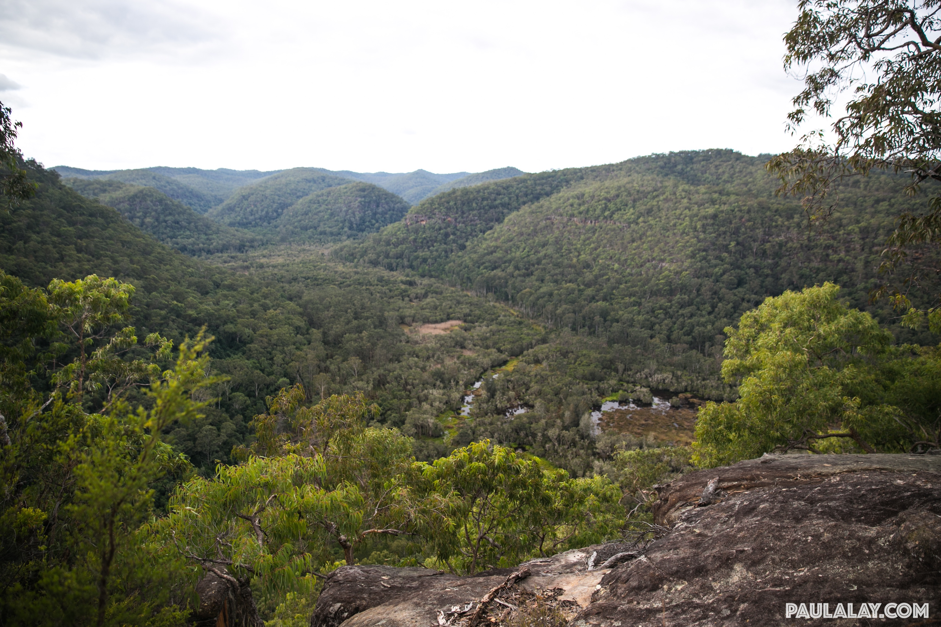
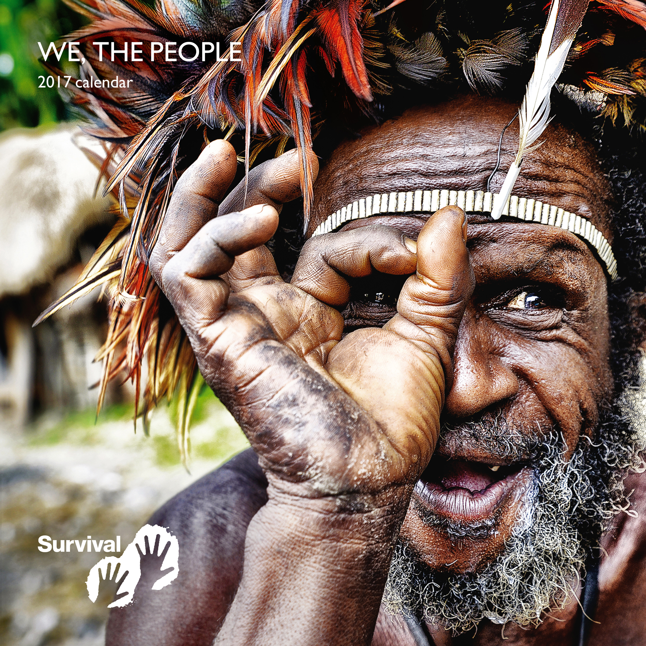
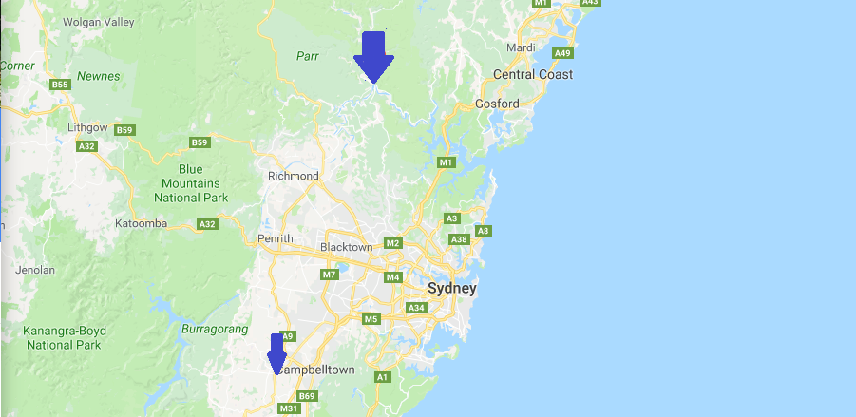

today
Law
Growth
Still not perfect, survival.

Slide 7
Our sources
http://www.koalanet.com.au/european-settlement.html https://www.youtube.com/watch?v=w1dc5uo17rY
https://aiatsis.gov.au/explore/articles/first-encounters-and-frontier-conflict http://www.visitsydneyaustralia.com.au/heritage-aboriginal-clans.html
https://en.wikipedia.org/wiki/Stolen_Generations
http://www.sydneybarani.com.au/sites/government-policy-in-relation-to-aboriginal-people/ http://aiatsis.gov.au/explore/articles/apology-australias-indigenous-peoples
https://en.wikipedia.org/wiki/National_Sorry_Day
https://www.australianstogether.org.au/discover/australian-history/stolen-generations https://www.rhtc.com.au/centre-info/darug-country
https://people.howstuffworks.com/aborigine5.htm
http://www.williamdawes.org/sydneylanguage.html
https://en.wikipedia.org/wiki/Slavery_in_Australia
https://www.aboriginalaffairs.nsw.gov.au/land-rights/alra
https://www.youtube.com/watch?v=QRBMdS4t36c2
https://www.youtube.com/watch?v=WBTRwP_YiAI&t=369s

Slide 8
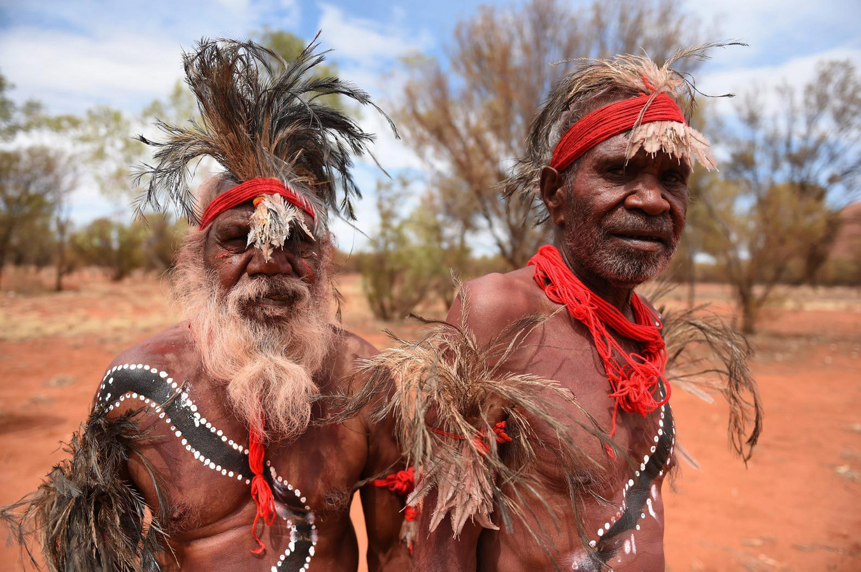
Thank you for listening!

